Slide 1
Securities and Exchange Commission EDGAR Stock Market 2020 Analysis (Quarters 1- 3)
Investment Analysis of Promising Emerging Companies
Notes:
Thorough investment analysis helps to see a company’s expenditures, its management’s efficiency in creating profits, and how positive the company's future prognosis is.
The purpose of this analysis is to compile multiple datasets containing annual financial statements from publicly traded companies over a 1-year period (2020), and create a model for determining the estimated value of a company based on its financial position using publicly available data.
The main goal of this analysis is to identify companies that are undervalued by the market, and whose share price is projected to increase in the future to make profitable investment decisions.
I am hoping that answering the data questions will enable me to use the findings to make good investment choices.

Slide 2
Data Questions
What are the top 3 financially strongest companies based on the annual Financial Statements reports (working capital, cash per share, current ratio, earnings per share)?
Does the Data show a trend?
Is it possible to forecast financial trends?
Notes:
What are the top 3 financially strongest companies based on the quarterly Financial Statements reports (average price per share, highest price per share, the lowest price per share, assets and liabilities, the amount of cash a company has, an amount of debt a company owes to lenders in the short term and long term, amount of cash a company generates, emerging competitors, a company’s management quality, what made those companies successful, a threshold of determining a financially strong company, a correlation between a company’s geographical location and its financial standing, actual and consensus earnings trends)?

Slide 3
What is EDGAR?
EDGAR, the Electronic Data Gathering, Analysis, and Retrieval system.
There are 8 data sets to review: submission, dimension, number, text, tag, presentation, rendering, and calculation.
All of them carry a certain value. However, we will focus specifically on the data sets submission and number.
Notes:
EDGAR is the primary system for companies and others submitting documents.
All companies, foreign and domestic, are required to file registration statements, periodic reports, and other forms electronically through EDGAR.

Slide 4
Let’s dive in…
Q1 2020, Q2 2020, Q3 2020
Notes:
Data contained in documents filed after 5:30PM Eastern on the last business day of a quarter will be included in the subsequent quarterly posting.

Slide 5
Submission Types of Reports
There are lots of types of the U.S. Securities and Exchange Commission forms that can be found at https://www.sec.gov/forms.
However, we will pay special attention to one of the most common forms, 10-K, Annual report.

Slide 6
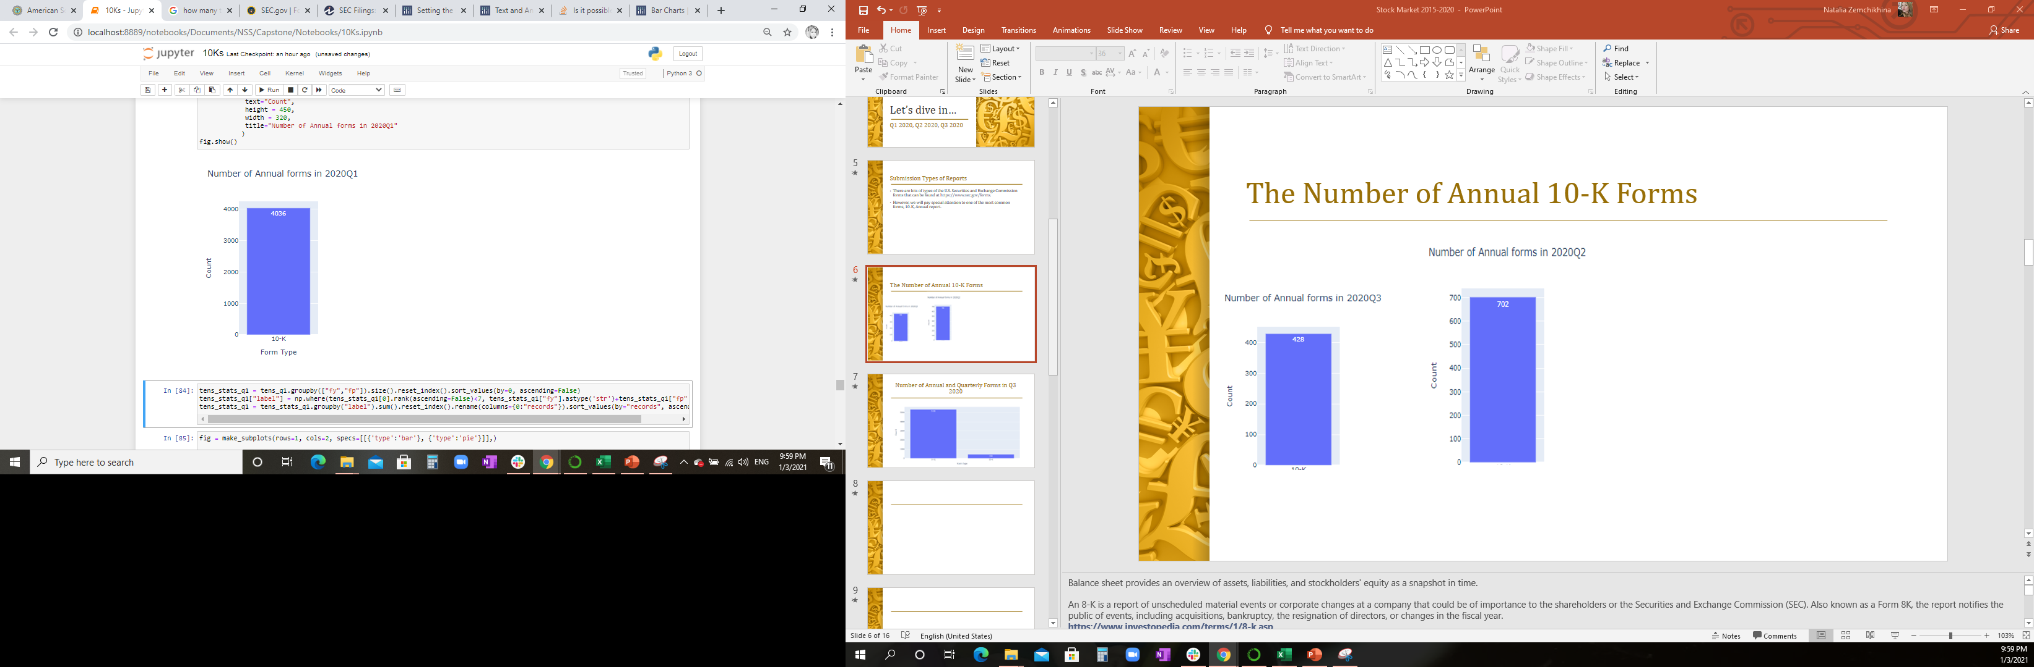
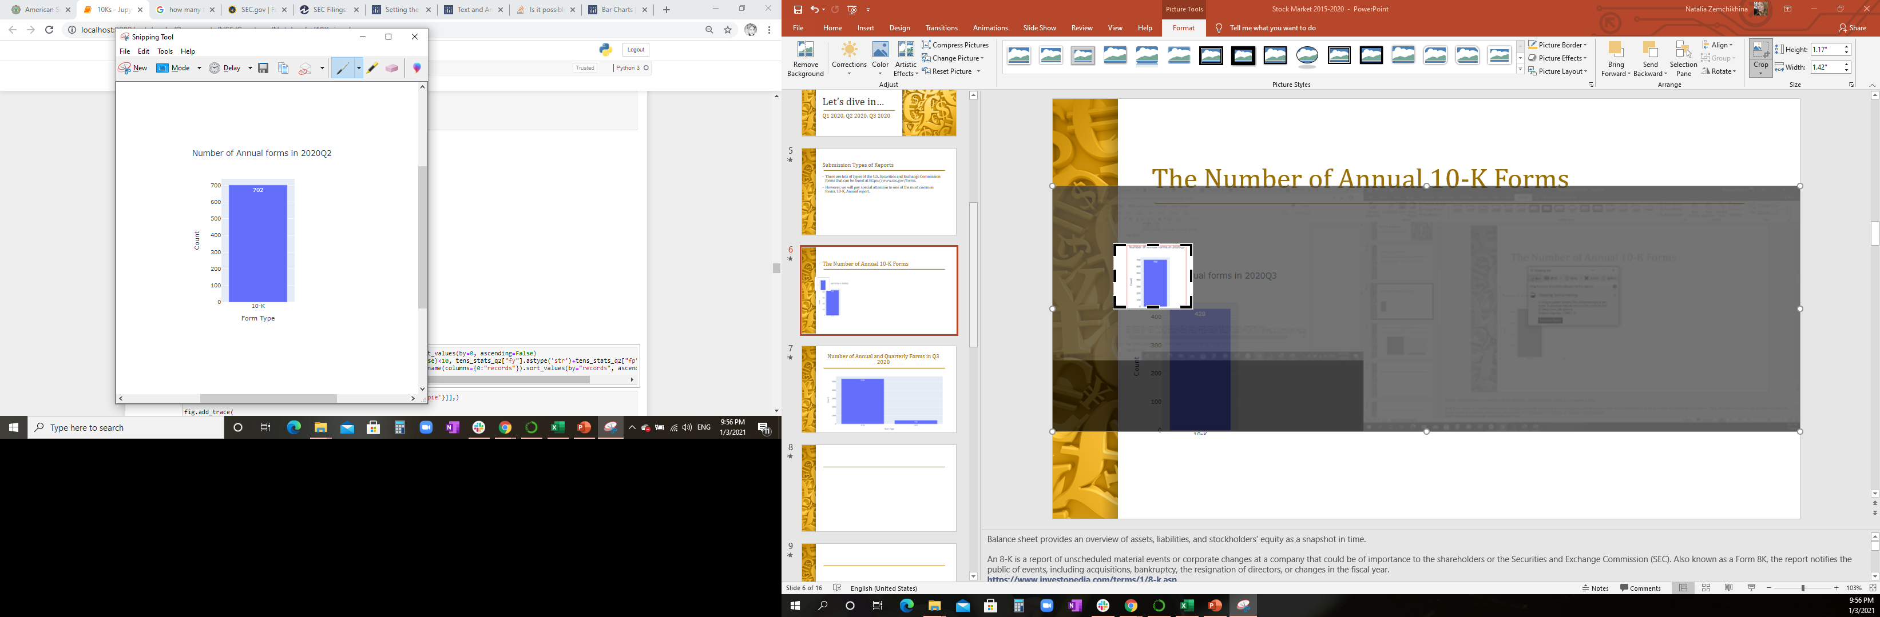
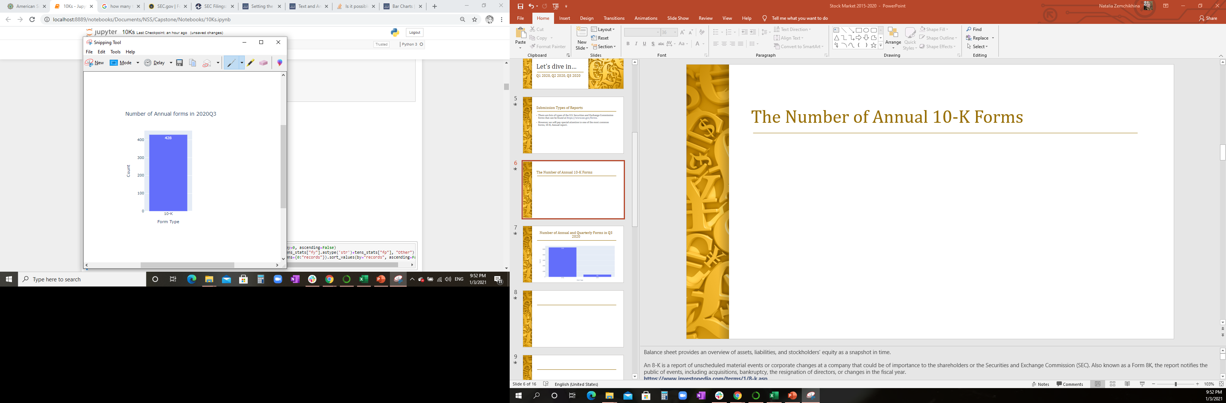

The Number of Annual 10-K Forms

Slide 7
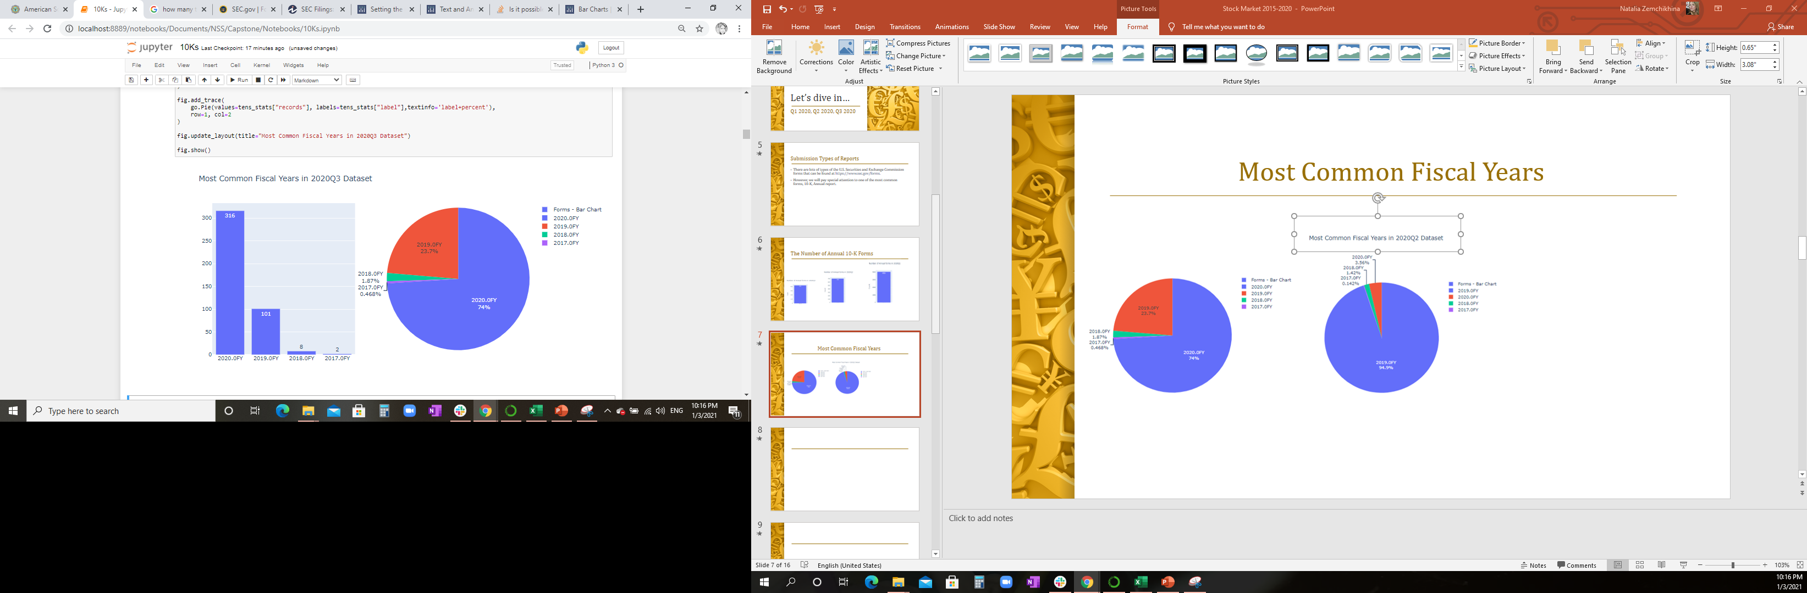
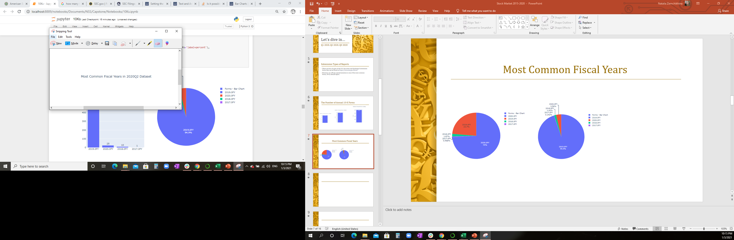
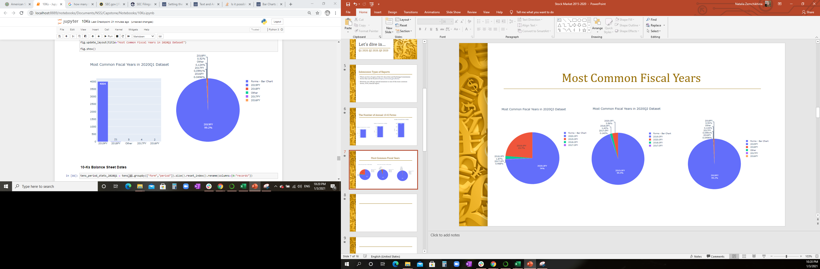
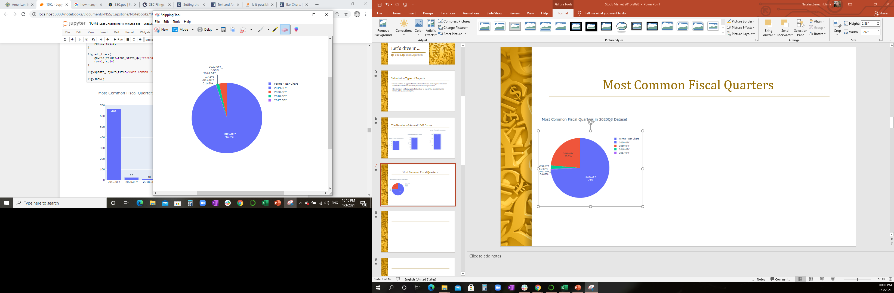
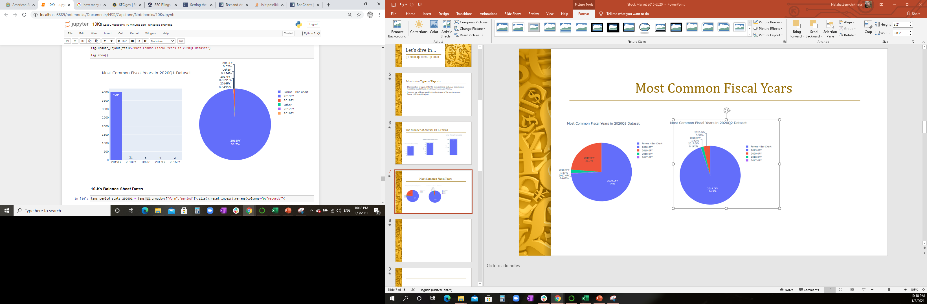
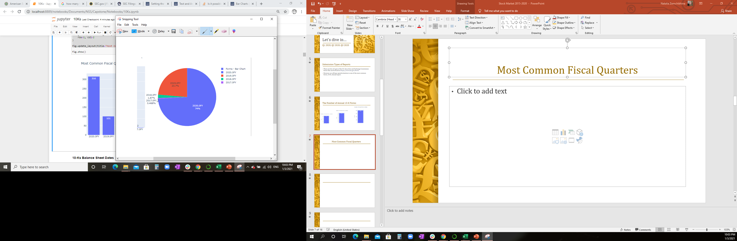
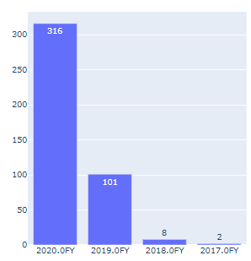
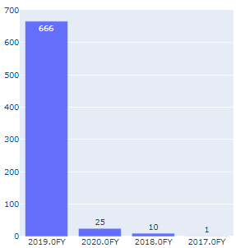
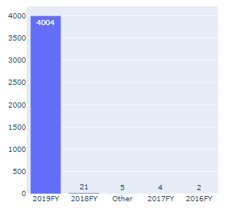
Most Common Fiscal Years

Slide 8
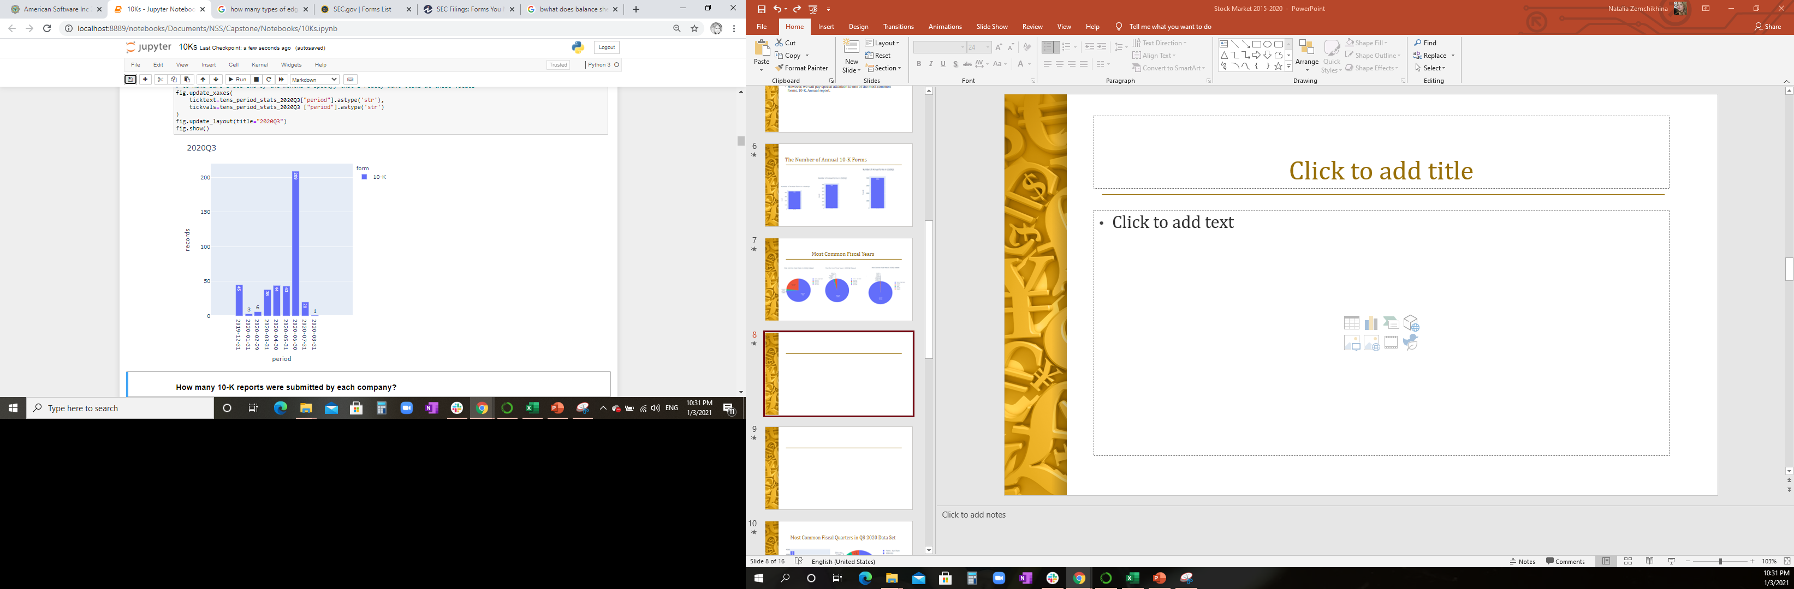
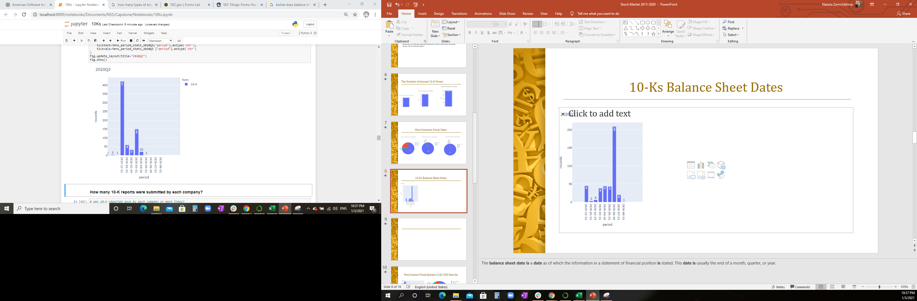
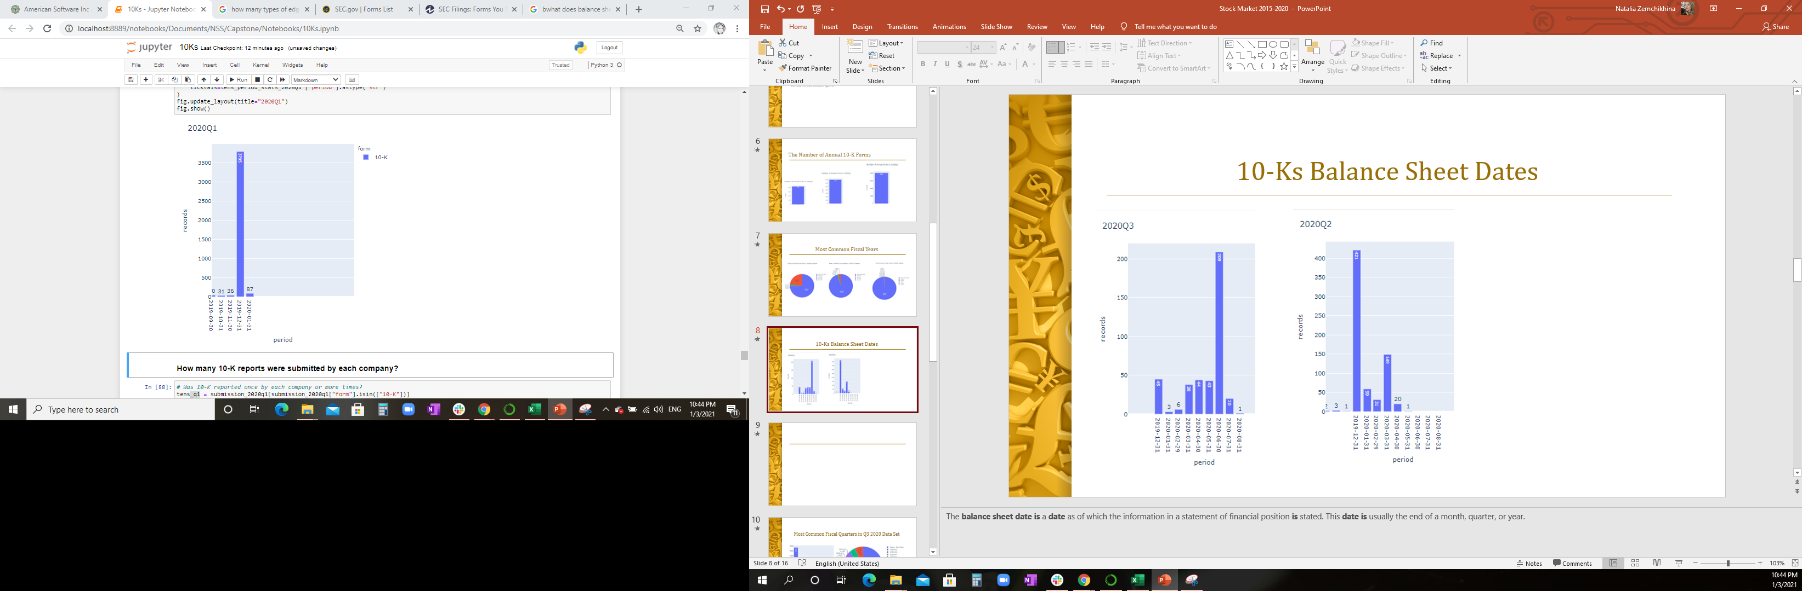
10-Ks Balance Sheet Dates
Notes:
The balance sheet date is a date as of which the information in a statement of financial position is stated. This date is usually the end of a month, quarter, or year. I started quiring data beginning September 2019 to make sure to have all of the possible 2020 data captured.

Slide 9
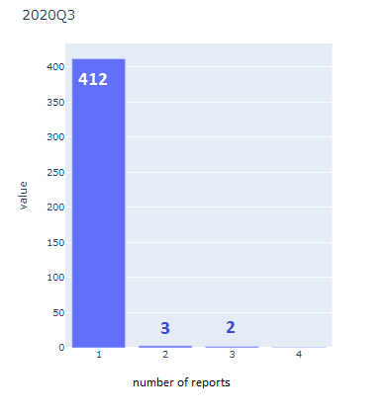
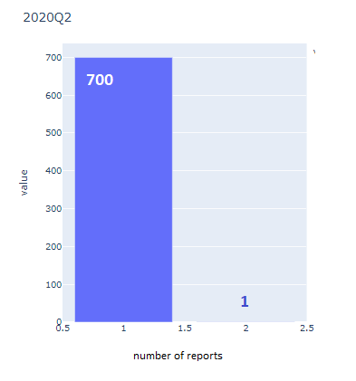
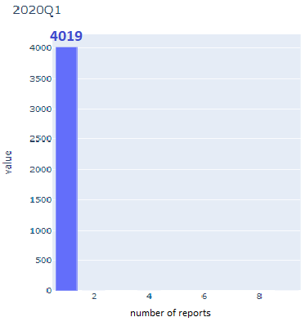
How many 10-K reports were submitted by each company?
The Number of 10-Ks Reported by Each Company
Notes:
412 out of 428, 700 out of 702 and 4019 out of 4036 total companies submitted only one report.

Slide 10
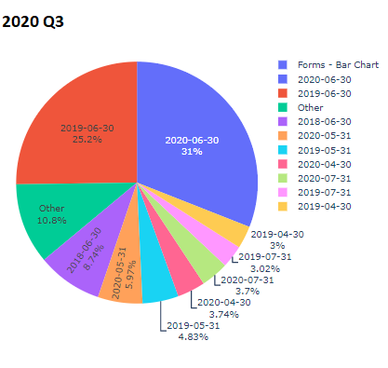
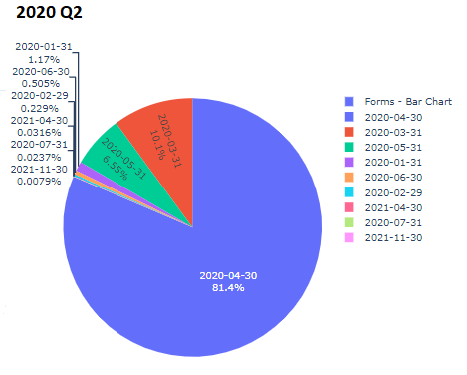
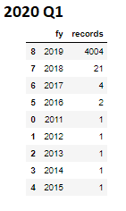
10-Ks Data in 2020 is valid through...
Notes:
The “ddate” column shows the end date for the data value, rounded to the nearest month end. There are no FY2020 filings in the 1st Quarter of 2020 data set. For 3rd Q of FY2020 the data dates start from 1987-06-30 through 2038-04-30. We see as historical financial data as the data having a future date here. Who would expect that?

Slide 11
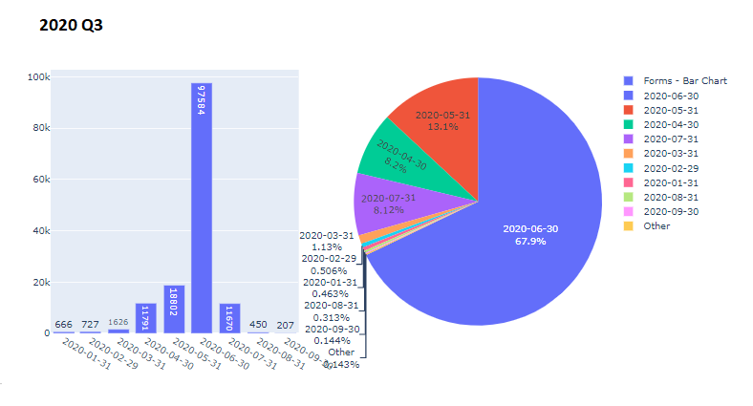
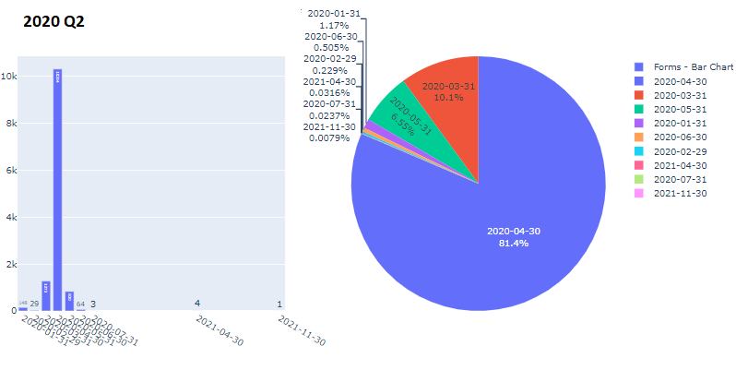
10-Ks FY2020 Only Data is Valid through…

Slide 12
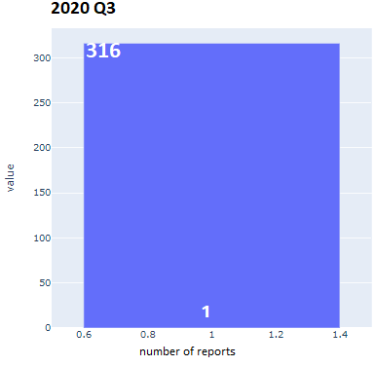
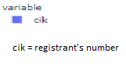
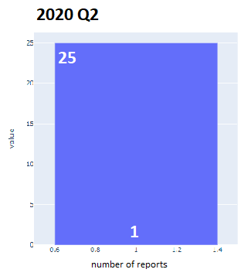
The Number of 10-Ks for FY 2020 Reported by Each Company
Notes:
Each out of 316 and 25 companies submitted filings for FY 2020 in their respective year quarters, presented 1 report only.

Slide 13
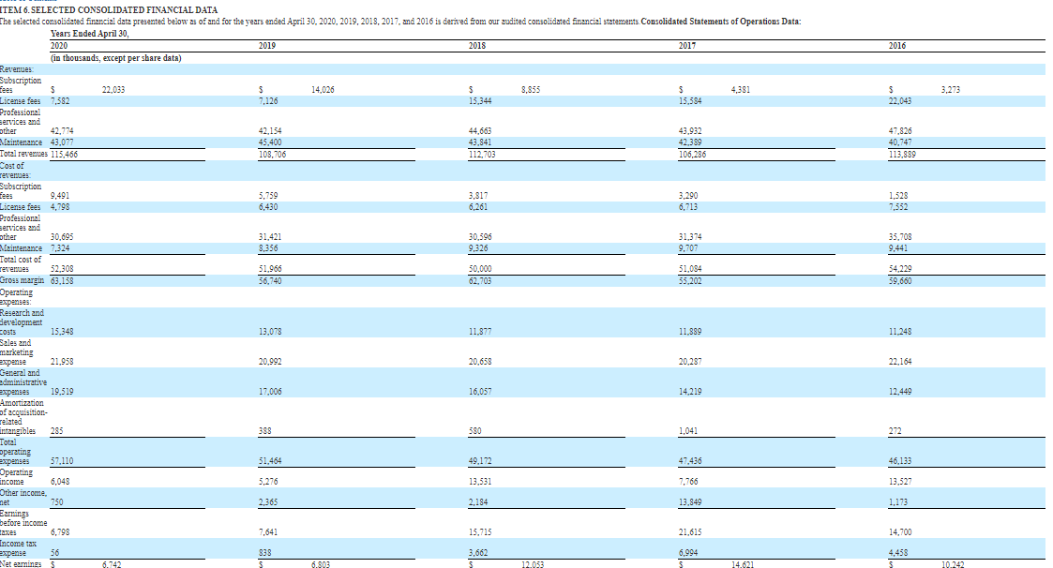
Just a 10-K snapshot of AMERICAN SOFTWARE, INC.
Notes:
This report is 90 pages long. The Balance Sheet is dated by April 30, 2020, however, the end date for the data value is June 30, 2020.

Slide 14
What are the top 3 companies?
Selection After Comparative Analysis
Company | Stock Price Increase after 10k release from June 30, 2020 - Present
MICROSOFT CORP | 10%
NIKE, INC. | 32%
KLA CORP | 26%
Notes:
On June 30th a quarterly report became available, which continued to increase the stocks prices.

Slide 15
Key Performance Indicators
The below formulas were used to select the top companies. Each company was present after the formulas were applied.
Key Performance Indicators
Current ratio is a liquidity ratio that helps you understand whether the business can pay its short-term obligations—that is, obligations due within one year— with its current assets and liabilities. Current Ratio = Current Assets / Current Liabilities
Working capital is a measure of the business’s available operating liquidity, which can be used to fund day-to-day operations. Working Capital = Current Assets - Current Liabilities
The gross profit ratio shows the proportion of profits generated by the sale of products or services, before selling and administrative expenses. It is used to examine the ability of a business to create sellable products in a cost-effective manner. (Sales – (Direct materials + Direct Labor + Overhead)) ÷ Sales
Earnings per share is calculated as a company's profit divided by the outstanding shares of its common stock. The resulting number serves as an indicator of a company's profitability. Earnings Per Share = net profit / number of common shares outstanding
Cash Per Share - is used to determine a firm's liquidity and is a good indicator of the overall financial health of a company. Cash Per Share = Total Cash / number of common shares outstanding

Slide 16
Five Year Common Stock Price Analysis

Slide 17
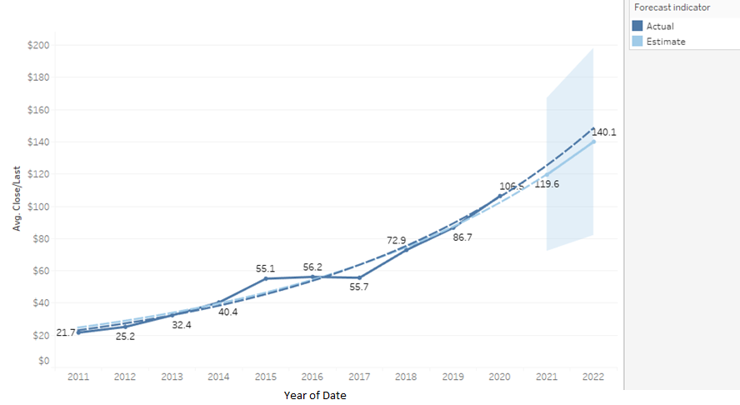
Average Share Price of Nike, Inc. Common Stock With Forecast

Slide 18
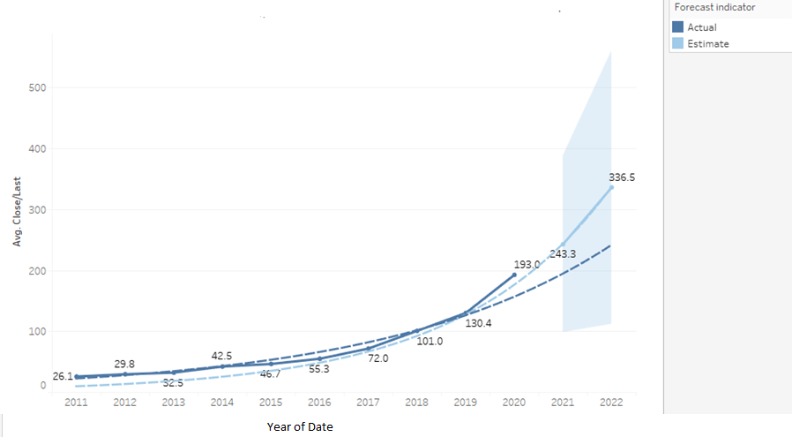
Average Share Price of Microsoft Common Stock With Forecast

Slide 19
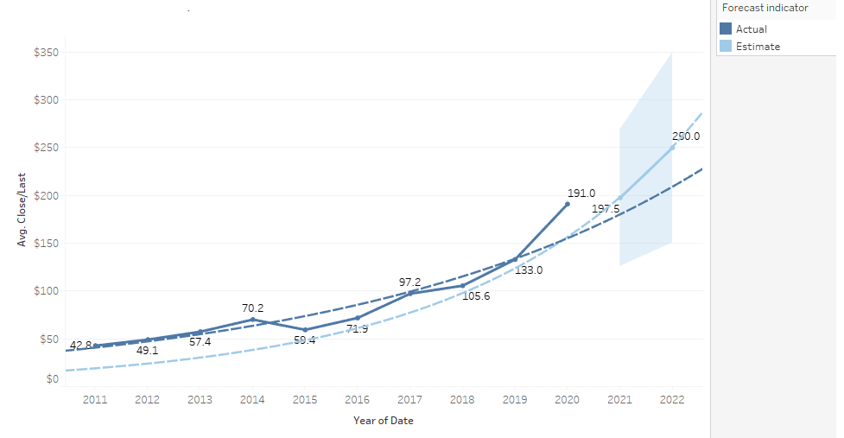
Average Share Price of KLA Corp Common Stock With Forecast

Slide 20
Conclusions
There’s a lot more to learn and more data questions to answer.
In the 2020 Q1 data set there are no filings for FY2020. Since 2020 Q4 has recently closed, the data is not yet available. We are left with 2 quarters of financial data to work with as of right now. In order to get a full FY2020 financial picture, we will have to wait for 2021 Q1 to close and the data is released.
The data sets contain historical filings.
The majority of companies submit only one 10-K report for a respective FY.
Microsoft, Nike, and KLA are the top undervalued stocks based on the conducted comparative analysis.
Data does show financial trends, and it is possible to forecast them. However, financial projections are a set of assumptions based on historical company and industry results.
The statements are open to interpretation, and as a result, investors often draw vastly different conclusions about a company's financial performance.
Never blindly accept what stock analysts have to say and always do your own research.
Incorporating more tables into the analysis will give so much more knowledge.

Slide 21
Glossary
Financial statements are written records that convey the business activities and the financial performance of a company.
Financial statements include:
Balance sheet provides an overview of assets, liabilities, and stockholders' equity as a snapshot in time;
Income statement primarily focuses on a company’s revenues and expenses during a particular period;
Cash flow statement measures how well a company generates cash to pay its debt obligations, fund its operating expenses, and fund investments.
A 10-K is a comprehensive report filed annually by a publicly-traded company about its financial performance: includes its history, organizational structure, financial statements, earnings per share, subsidiaries, executive compensation, and any other relevant data.
Investment analysis is a broad term for many different methods of evaluating investments, industry sectors, and economic trends. It can include charting past returns to predict future performance, selecting the type of investment that best suits an investor's needs, or evaluating individual securities such as stocks and bonds to determine their risks, yield potential, or price movements.
Stocks are equity investments that represent ownership in a company. Stocks = “shares” or “equities”. You are a (part) business owner.
Companies issue shares as a means to raise large amounts of capital to fund projects that will ultimately lead to growth and create a return for investors.
The stock price of a company is simply the market's determination of the company's value, which is dependent on its assets, its current profits, and its expected future profits amongst other things.

Slide 22
Glossary (cont.)
A fiscal year is a one-year period that companies and governments use for financial reporting and budgeting. A fiscal year is most commonly used for accounting purposes to prepare financial statements. Although a fiscal year can start on January 1st and end on December 31st, not all fiscal years correspond with the calendar year.
Fiscal years that vary from a calendar year are typically chosen due to the specific nature of the business. According to the IRS, a fiscal year consists of 12 consecutive months ending on the last day of any month except December.

Slide 23
Sources
https://www.sec.gov/
https://www.sec.gov/edgar/search-and-access
https://www.sec.gov/dera/data/financial-statement-data-sets.html
https://www.google.com/finance
https://finance.yahoo.com/
https://www.investopedia.com/terms/i/investment-analysis.asp#:~:text=Investment%20analysis%20involves%20researching%20and,creating%20an%20overall%20financial%20strategy.
https://finance.zacks.com/seven-ways-analyze-stock-4845.html
https://www.investopedia.com/terms/f/financialmodeling.asp
https://archive.mbda.gov/news/blog/2010/08/financial-strength-and-ratio-analysis.html
https://www.investopedia.com/articles/basics/09/become-your-own-stock-analyst.asp
https://www.investopedia.com/articles/investing/041114/simple-overview-quantitative-analysis.asp
https://www.chainofdemand.co/the-power-of-predictive-analytics/
https://www.nerdwallet.com/article/investing/stock-market-basics-everything-beginner-investors-know
https://www.thebalance.com/guide-to-understanding-financial-statements-357512
https://pinnacle-business.com/measuring-business-financial-strength/
https://www.synario.com/resources/articles/getting-started/a-simple-guide-to-the-10-types-of-financial-models?campaignid=9503953380&adgroupid=105310358307&adid=440676176561&gclid=Cj0KCQiAqo3-BRDoARIsAE5vnaKo2bpqZIRNInc0h5IxE9XEIk_97EBpKUd4XzRx9pq6Qv04HKZNZ1AaAvnVEALw_wcB
https://www.investopedia.com/articles/investing/061916/what-best-measure-companys-financial-health.asp
https://www.investopedia.com/articles/fundamental-analysis/08/sec-forms.asp

Slide 24
Sources (continued)
https://www.investopedia.com/articles/fundamental-analysis/11/calculating-required-rate-of-return.asp
https://gbr.pepperdine.edu/2010/08/the-role-of-finance-in-the-strategic-planning-and-decision-making-process/
https://www.americancentury.com/content/direct/en/insights/guidance-planning/general-investing/general-investing-insights/fundamental-vs-quantitative.html
https://www.chainofdemand.co/the-power-of-predictive-analytics/
https://www.cashay.com/how-to-do-investment-analysis-123617633.html?guccounter=1&guce_referrer=aHR0cHM6Ly93d3cuZ29vZ2xlLmNvbS8&guce_referrer_sig=AQAAABWh8ptUeYowaXy3bv_RMrtOI2-IVsznv8JHLl1Xr13VeQIOG15262vXfxnOaTc0kHUZXmmOOVD7yZYAP9IvrM9EflIFdFIY1eYQh8jBTcBvrJFwLF_E40IiIJYpXqlcXgXc1kIEak0FC8Ef0RPBGo2BJKZdQ8azFNm7vAbaIgEC
https://corporatefinanceinstitute.com/resources/knowledge/modeling/what-is-financial-modeling/
https://corporatefinanceinstitute.com/resources/knowledge/modeling/financial-modeling-for-beginners/
https://www.synario.com/resources/articles/getting-started/a-simple-guide-to-the-10-types-of-financial-models?campaignid=9503953380&adgroupid=105310358307&adid=440676176561&gclid=Cj0KCQiAqo3-BRDoARIsAE5vnaKo2bpqZIRNInc0h5IxE9XEIk_97EBpKUd4XzRx9pq6Qv04HKZNZ1AaAvnVEALw_wcB
https://www.investopedia.com/articles/investing/061916/what-best-measure-companys-financial-health.asp
https://marketsmith.investors.com/Learn/Topic.aspx?name=Analyzing%2BStocks&type=4
https://www.accountingtools.com/articles/2017/5/16/current-ratio#:~:text=What%20is%20the%20Current%20Ratio%3F&text=Since%20the%20ratio%20is%20current,pay%20in%20a%20timely%20manner
https://online.hbs.edu/blog/post/financial-performance-measures
https://www.investopedia.com/terms/e/eps.asp
https://www.Nasdaq.com

Slide 25
Questions?

